Slide 1
Tuning Intel LPMD for energy optimization for gaming workloads
Srinivas Pandruvada, Casey Bowman, Intel

Slide 2
Why I’m here
I’m not a gaming expert
  I’ve worked in power and thermal management for over a decade
  I want to improve energy efficiency in gaming workloads
    Especially on compact laptops and handhelds
  Maximum performance isn’t always the best choice
I’m sharing an idea and an approach—not a final answer
  LPMD shows the potential of these controls
LPMD demonstrates improvement using these knobs
2
Notes:
The knobs: core selection, CPU-vs-GPU power split, frequency ramp, a
performance floor. All of them already work. What I do not have is a
defensible policy for setting them.
"Better is not one number" -- unpack with the cases:
- handhelds and thin laptops: a frame rate you cannot sustain thermally,
or that halves battery life, is not the frame rate you shipped
- at 45 FPS, efficiency arguments are irrelevant. Get the frames.
- above the panel's refresh ceiling, performance is nearly free to trade.
Frames past 120 Hz on a 120 Hz panel buy the player nothing.
"Frame pacing is not frame rate" is the one that surprised me: a game with
very low CPU utilisation can stutter precisely because the CPU never ramps,
while average FPS looks fine. That is a governor problem masquerading as a
GPU problem, and it is the case where LPMD helped most.
So the target is a position on a curve, and different games, different power
sources and different players want different positions. Nothing in the
kernel or in LPMD knows which position was wanted.

Slide 3
Objective
Gaming prioritizes performance
  Performance per watt matters too
    Especially for battery life and thermal management
Show how power-management controls affect performance per watt
  LPMD can be tuned to use these controls
    Other gaming daemons can use the same controls
3
Notes:
The knobs: core selection, CPU-vs-GPU power split, frequency ramp, a
performance floor. All of them already work. What I do not have is a
defensible policy for setting them.
"Better is not one number" -- unpack with the cases:
- handhelds and thin laptops: a frame rate you cannot sustain thermally,
or that halves battery life, is not the frame rate you shipped
- at 45 FPS, efficiency arguments are irrelevant. Get the frames.
- above the panel's refresh ceiling, performance is nearly free to trade.
Frames past 120 Hz on a 120 Hz panel buy the player nothing.
"Frame pacing is not frame rate" is the one that surprised me: a game with
very low CPU utilisation can stutter precisely because the CPU never ramps,
while average FPS looks fine. That is a governor problem masquerading as a
GPU problem, and it is the case where LPMD helped most.
So the target is a position on a curve, and different games, different power
sources and different players want different positions. Nothing in the
kernel or in LPMD knows which position was wanted.

Slide 4
Power Management Controls
SoC performance slider
  0 = maximum performance; 6 = lowest performance
  Slider offset
    Firmware can automatically optimize the offset
Core types
  P-cores, E-cores, and LPE cores
    Each type has different energy efficiency
CPU frequency limits
CPU–GPU power balancing
Scheduler utilization clamps
4
Notes:
The knobs: core selection, CPU-vs-GPU power split, frequency ramp, a
performance floor. All of them already work. What I do not have is a
defensible policy for setting them.
"Better is not one number" -- unpack with the cases:
- handhelds and thin laptops: a frame rate you cannot sustain thermally,
or that halves battery life, is not the frame rate you shipped
- at 45 FPS, efficiency arguments are irrelevant. Get the frames.
- above the panel's refresh ceiling, performance is nearly free to trade.
Frames past 120 Hz on a 120 Hz panel buy the player nothing.
"Frame pacing is not frame rate" is the one that surprised me: a game with
very low CPU utilisation can stutter precisely because the CPU never ramps,
while average FPS looks fine. That is a governor problem masquerading as a
GPU problem, and it is the case where LPMD helped most.
So the target is a position on a curve, and different games, different power
sources and different players want different positions. Nothing in the
kernel or in LPMD knows which position was wanted.

Slide 5
Inputs
Hardware workload and scenario hints
  No polling required
Hardware counters for CPU and GPU utilization
Scheduler CPU-utilization metrics
User preferences from configuration
Power-profiles-daemon preferences
Power source (AC/DC)
Hardware Feedback Interface (HFI)
5
Notes:
The knobs: core selection, CPU-vs-GPU power split, frequency ramp, a
performance floor. All of them already work. What I do not have is a
defensible policy for setting them.
"Better is not one number" -- unpack with the cases:
- handhelds and thin laptops: a frame rate you cannot sustain thermally,
or that halves battery life, is not the frame rate you shipped
- at 45 FPS, efficiency arguments are irrelevant. Get the frames.
- above the panel's refresh ceiling, performance is nearly free to trade.
Frames past 120 Hz on a 120 Hz panel buy the player nothing.
"Frame pacing is not frame rate" is the one that surprised me: a game with
very low CPU utilisation can stutter precisely because the CPU never ramps,
while average FPS looks fine. That is a governor problem masquerading as a
GPU problem, and it is the case where LPMD helped most.
So the target is a position on a curve, and different games, different power
sources and different players want different positions. Nothing in the
kernel or in LPMD knows which position was wanted.

Slide 6
LPMD
User-space daemon
Optimizes performance per watt by CPU generation
  Default policy
    Configured through a CPU-generation XML file
    Users can customize the behavior
Classifies tasks by PID or cgroup and assigns resources
6
Notes:
The knobs: core selection, CPU-vs-GPU power split, frequency ramp, a
performance floor. All of them already work. What I do not have is a
defensible policy for setting them.
"Better is not one number" -- unpack with the cases:
- handhelds and thin laptops: a frame rate you cannot sustain thermally,
or that halves battery life, is not the frame rate you shipped
- at 45 FPS, efficiency arguments are irrelevant. Get the frames.
- above the panel's refresh ceiling, performance is nearly free to trade.
Frames past 120 Hz on a 120 Hz panel buy the player nothing.
"Frame pacing is not frame rate" is the one that surprised me: a game with
very low CPU utilisation can stutter precisely because the CPU never ramps,
while average FPS looks fine. That is a governor problem masquerading as a
GPU problem, and it is the case where LPMD helped most.
So the target is a position on a curve, and different games, different power
sources and different players want different positions. Nothing in the
kernel or in LPMD knows which position was wanted.

Slide 7
Default policy — the six states, in match order
ID | Name | WLT | Matches | Cores | Slider range
1 | UTIL_IDLE_GFX_BUSY | 1 | GFX 20–100% | E + LPE | 3 (+min_perf_pct=50
2 | UTIL_NON_IDLE_LOW_SYS | 12 | sys ≤ 30%, GFX 95–100% | E + LPE | 4–6
3 | UTIL_NON_IDLE_LT_GFX | 12 | GFX 20–50% | E + LPE | 3–5
4 | UTIL_BUSY_GFX_BUSY | 12 | GFX 50–100% | E + LPE | 4–6
5 | UTIL_IDLE | 1 | catch-all | LPE only | 3–6
6 | UTIL_NON_IDLE | 12 | catch-all | all | 1
Only E-cores in state 4 also showed even better results for some benchmarks
7
Notes:
The single most important sentence: the order in the file is the priority
order, and <ID> is documentary only -- it appears in log messages and
nowhere else, so nothing looks a state up by it. The IDs are numbered to
follow document order so a log line and this table read the same way; if
someone inserts a state, renumber rather than append.
Read the table as a decision list:
State 2 is the one to talk about. "System load under 30% while the GPU is
pegged at 95%+" is the signature of a GPU-bound game, and it is placed
ahead of state 4, which would also match a 95% GFX load. It gets the
GPU-biased split AND the CPU floor -- the combination that produced the
Strange Brigade result.
State 1 is the same idea under an Idle hint: the CPU is genuinely idle but
the GPU is working. Without the GFX signal this is indistinguishable from
a laptop sitting on a desk, and the two want opposite policies. That
distinction is the reason the GFX load input exists at all.
States 3 and 4 divide non idle by how much of the work is on the GPU:
some (state 3, GFX 20-50%) and most (state 4, GFX 50%+). Below 20% GFX
the load is CPU bound with an idle GPU, and it falls to state 6.
State 6 is the non-gaming row and the most CPU-favouring state in the
table: slider pinned at 1, no offset, every core type including the
P-cores. A compile lands there. Say it explicitly if someone asks
whether this hurts non-gaming work -- a build gets more CPU than any
gaming state gives, not less.
Be precise about the slider if it comes up, because the direction is
counter-intuitive. SliderOffset does not set a frequency; it widens the
range the hardware may sit in, from BalanceSlider up to BalanceSlider +
SliderOffset. Higher means the hardware is permitted to shift further
toward the GPU, so a bigger number is LESS CPU performance, not more.
State 3's "3 / 2" means anywhere in 3-5. State 6's "1 / 0" pins it at 1.
That is why every gaming state sits high and state 6 sits at 1. On a 25 W
part the P-cores have the worst efficiency curve and the highest turbo,
so both the core mask and the slider are pulling in the same direction:
stop the CPU spending budget the GPU wanted.
If asked "why 20 / 30 / 50 / 95": those are the first values that worked.
No sweep. This is the tuning I am asking for guidance on.

Slide 8
Task classification
Classifies default tasks launched by the distribution
  Classes include real-time, user-interactive, user-initiated, unclassified, utility, background, and GameProfileCPU/GPU/Hybrid/1–3
Each profile can use different controls
Games can be assigned to a Game profile
8
Notes:
The knobs: core selection, CPU-vs-GPU power split, frequency ramp, a
performance floor. All of them already work. What I do not have is a
defensible policy for setting them.
"Better is not one number" -- unpack with the cases:
- handhelds and thin laptops: a frame rate you cannot sustain thermally,
or that halves battery life, is not the frame rate you shipped
- at 45 FPS, efficiency arguments are irrelevant. Get the frames.
- above the panel's refresh ceiling, performance is nearly free to trade.
Frames past 120 Hz on a 120 Hz panel buy the player nothing.
"Frame pacing is not frame rate" is the one that surprised me: a game with
very low CPU utilisation can stutter precisely because the CPU never ramps,
while average FPS looks fine. That is a governor problem masquerading as a
GPU problem, and it is the case where LPMD helped most.
So the target is a position on a curve, and different games, different power
sources and different players want different positions. Nothing in the
kernel or in LPMD knows which position was wanted.

Slide 9
Setup
Panther Lake laptop
  4 P-cores, 8 E-cores, 4 LPE cores; integrated Arc GPU
Panther Lake handheld (8-inch)
  2 P-cores, 8 E-cores, 4 LPE cores; integrated Arc GPU
Baseline: LPMD stopped
Default: Panther Lake LPMD configuration
  No game-specific performance tuning
Average of 3 runs, plus one warm-up
Default in-game benchmark
Reported metrics: average FPS, mean package power, and FPS/W
9
Notes:
Say this explicitly, because it is the first question otherwise: LPMD did not
get more power. thermald applies the same package cap to both runs -- on the
handheld that is 37 W dropped to 25 W. LPMD redistributes a fixed budget.
Why the cap matters: at 37 W the SoC has budget enough that CPU and GPU
barely compete. At 25 W they do, and that is where core selection and the
power split start to matter at all. If you run these experiments uncapped you
will measure nothing.
"LPMD default" is deliberate wording -- this is LPMD running its shipped
config, not a hand-tuned one. The tuning in the title is what LPMD makes
possible, not what produced these numbers.
FPS/W is derived from the two measured columns, never measured separately, so
it carries the error of both.
Handheld detail is on the backup platform slide. Laptop SKU and cap still
need filling in there -- do not claim a number for it from the stage.

Slide 10
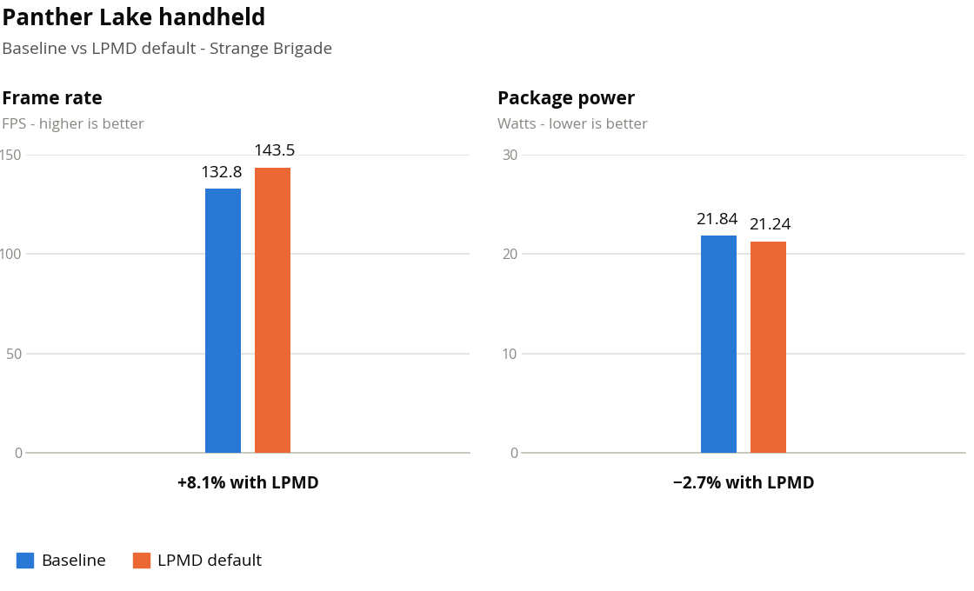
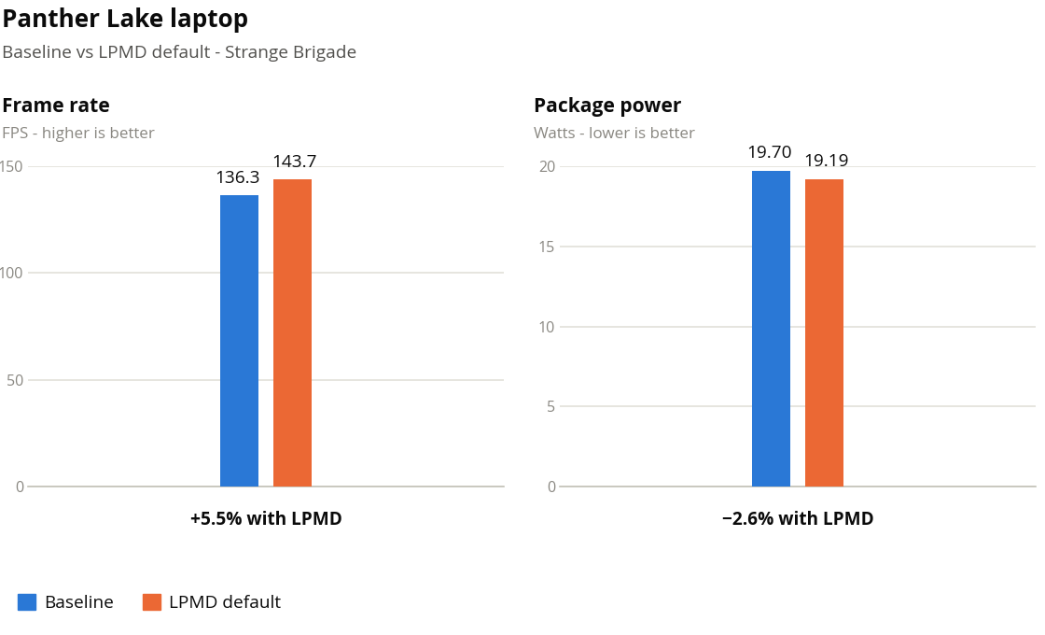
Strange Brigade
Performance per watt: +11.1% handheld, +8.3% laptop
Frame-pacing case: MinPerfPct 50 floor
10

Slide 11
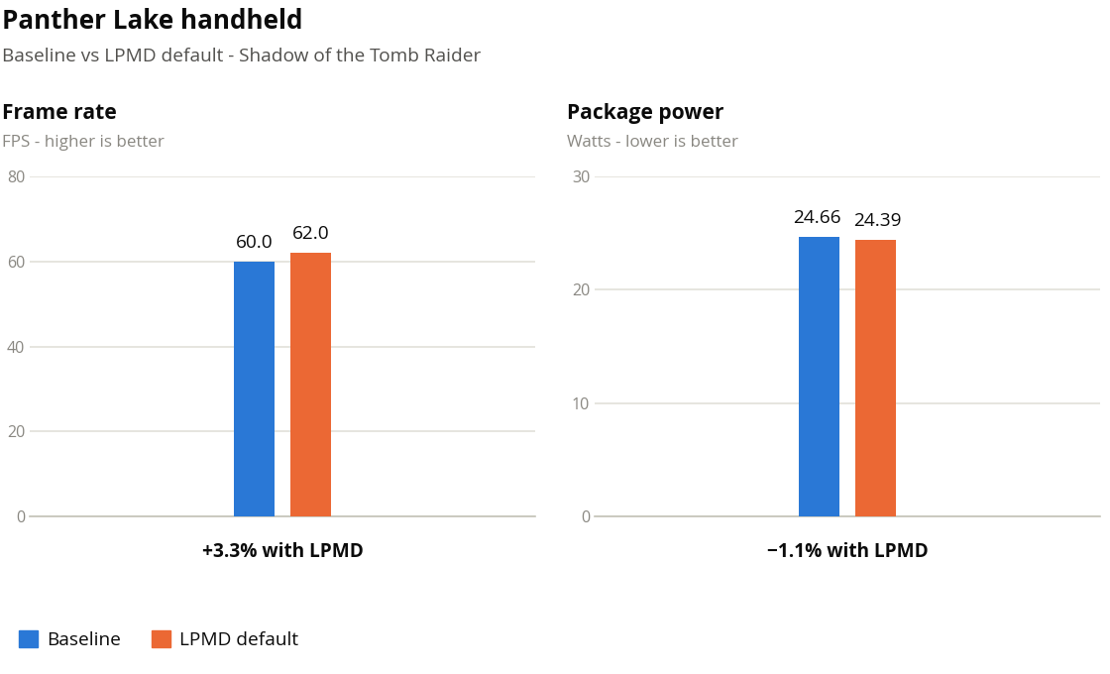
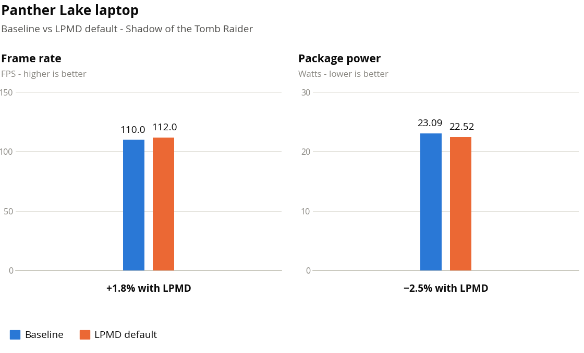
Shadow of the Tomb Raider
Performance per watt: +4.5% handheld, +4.4% laptop
Both engines are busy—the contended case
11
Notes:
Both CPU and GPU are genuinely busy here, so the two engines compete for one
budget. This is where naive "give the CPU more frequency" actively hurts:
biasing the split toward the GPU and holding back the ramp moves both numbers
the right way at once, on both platforms.
Small gains -- 1.8% to 4.5% efficiency. Consistent direction across two very
different platforms is the part I would defend; the magnitudes are within the
variance I have not characterised.
Classified game_profile_mixed via the ShadowOfTheTomb* glob.
Known data issue if anyone reads the capture: the laptop's reported baseline
FPS/W is 4.620, but 110 / 23.089 = 4.764. The chart plots the derived value.
The reported column has a bug; the FPS and watts are what I trust.

Slide 12
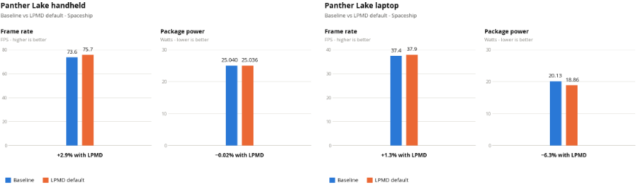
Spaceship
Performance per watt: +2.9% handheld, +8.2% laptop
12

Slide 13
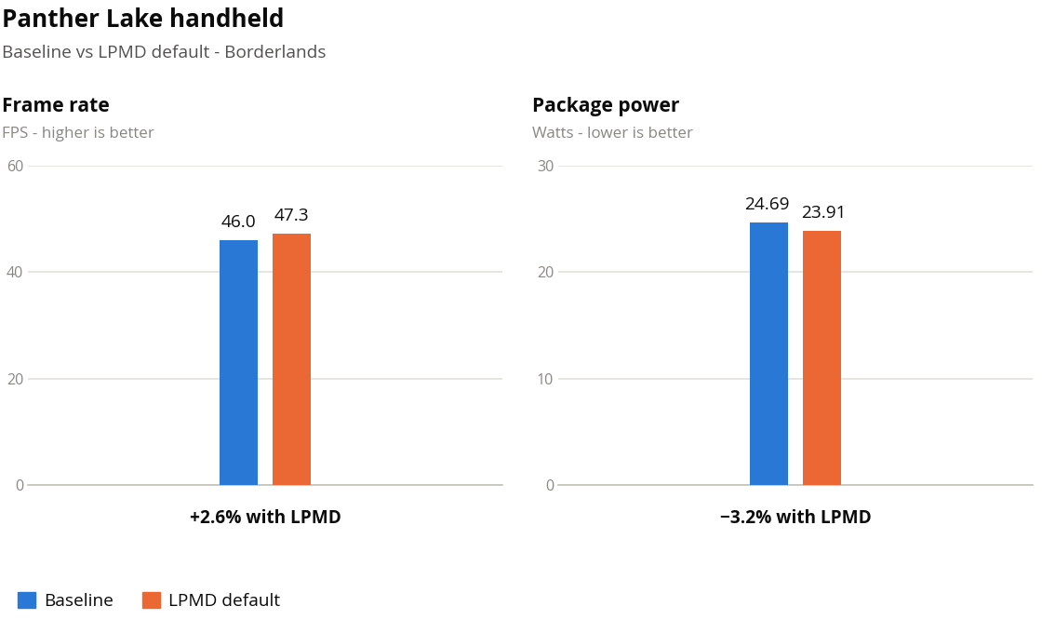
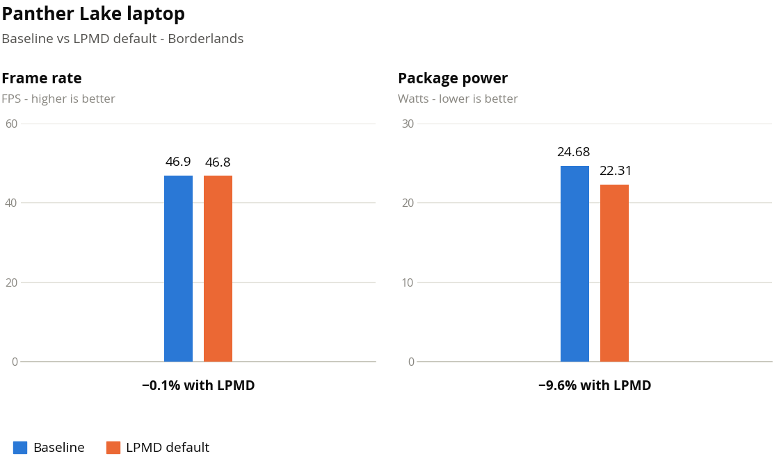
Borderlands 3
Performance per watt: +6.0% handheld, +10.5% laptop
13

Slide 14
Thank you
Srinivas Pandruvada · srinivas.pandruvada@linux.intel.com
intel_lpmd — patches and config contributions welcome
14

Slide 15
Backup
Configuration walkthrough, control reference, and the full knob list
git.kernel.org → intel_lpmd · data/intel_lpmd_config_*.xml, data/process_cpuset.xml
15

Slide 16
Backup — configuration layout
Four files, in increasing specificity:
File | Role
intel_lpmd_config.xml | daemon-wide: hint sources, power-profile defaults, poll intervals
intel_lpmd_config_F6_M204.xml | per-CPU-model <States> and <ClassDefaults> overlays
process_cpuset.xml | process → class map, plus built-in <ClassDefaults>
process_cpuset_user.xml | user overrides, instead of editing shipped files
None of this is code — adding a platform is a config file, not a patch
Resolution order for a single knob is the next slide
16
Notes:
The point of the split: the daemon-wide file is policy that applies
everywhere, the per-CPU-model file is where silicon-specific tuning lives,
and process_cpuset.xml is the process-to-class map. A new SKU needs an
entry in the second one and nothing else.
process_cpuset_user.xml is the one to point users at. It is not shipped, so
it survives package updates, and it is last in the resolution chain.

Slide 17
Backup — per-SKU overlays
One CPUModel can carry several <States> blocks, chosen by <CPUConfig>:
<States>
<CPUFamily>6</CPUFamily> <CPUModel>204</CPUModel>
<CPUConfig> * </CPUConfig> <!-- what F6_M204 ships today -->
<ClassDefaults> ... </ClassDefaults>
<State> ... </State> <!-- the six states -->
</States>
Most specific CPUConfig wins, * is the catch-all
Intended for same model, different power budget — a 25 W handheld vs a 45 W laptop
Both measured platforms currently resolve to the catch-all block — one state table, two very different machines
17
Notes:
Have this ready, because it is the obvious objection to the results: the
handheld and the laptop are the same CPU model, and they hit the same
config. There is no per-SKU tuning behind these numbers.
That cuts both ways, and I would rather say both:
For -- one state table moved efficiency the right way on two machines with
different form factors, different caps and roughly 2x different frame
rates. The load-band approach adapts without being told which machine it
is on, which is the whole argument.
Against -- it also means neither platform is tuned. A 25 W handheld and a
laptop almost certainly want different thresholds and a different power
split, and the mechanism to express that exists and is unused. Some of the
small 1-3% results are probably a tuned overlay away from being larger.
An earlier revision did carry a separate 2P8E4L-25W block for the handheld.
It was removed rather than maintained in parallel, because two divergent
state tables made it impossible to say which one produced a given number.
Reintroducing it, with a sweep behind it, is on the list of experiments I
would like the room to prioritise.

Slide 18
Backup — global configuration knobs
<PerformanceDef>2</PerformanceDef> <!-- -1 off · 0 auto · 1 always · 2 process-affinity based -->
<BalancedDef>0</BalancedDef>
<PowersaverDef>-1</PowersaverDef>
<WLTHintEnable>1</WLTHintEnable> <!-- use hardware workload-type hints -->
<WLTHintPollEnable>1</WLTHintPollEnable>
<WLTHintMask>15</WLTHintMask> <!-- AND mask against the hardware hint -->
<HfiLpmEnable>0</HfiLpmEnable>
<HfiSuvEnable>0</HfiSuvEnable>
<UseProcessCPUSet>1</UseProcessCPUSet> <!-- honour per-process cpuset config -->
<IgnoreITMT>0</IgnoreITMT>
<BalancedSliderAC>1</BalancedSliderAC> <!-- global slider defaults -->
<BalancedSliderDC>3</BalancedSliderDC>
<SliderOffsetAC>0</SliderOffsetAC>
<SliderOffsetDC>3</SliderOffsetDC>
18

Slide 19
Backup — a <State> in full
<State>
<ID> 4 </ID>
<Name> UTIL_BUSY_GFX_BUSY </Name>
<WLTTypeMask> 12 </WLTTypeMask> <!-- WLT types 2 and 3 -->
<EnterGFXLoadThres>100</EnterGFXLoadThres> <!-- upper bound of the band -->
<ExitGFXLoadThres>50</ExitGFXLoadThres> <!-- lower bound -->
<ExitGFXLoadHysteresis>5</ExitGFXLoadHysteresis> <!-- holds down to 45% -->
<ActiveEcores>*</ActiveEcores> <!-- P-cores withheld -->
<ActiveLcores>*</ActiveLcores>
<MinPerfPctAC>0</MinPerfPctAC> <!-- stated, not inherited -->
<BalanceSliderAC>4</BalanceSliderAC> <!-- GPU-biased: both engines busy -->
<SliderOffsetAC>2</SliderOffsetAC>
<MinPollInterval> 1000 </MinPollInterval> <!-- grows while the state is stable -->
<PollIntervalIncrement> 500 </PollIntervalIncrement>
<MaxPollInterval> 2000 </MaxPollInterval>
</State>
19
Notes:
The band is the part to explain, because the tag names mislead: EnterThres
is the UPPER bound and ExitThres the LOWER one. This state is "GFX between
50% and 100%".
The hysteresis is what stops thrashing. A GPU load jittering around 50%
would otherwise hand the state machine back and forth between this state
and UTIL_NON_IDLE_LT_GFX on every poll, and each flip rewrites cpusets and
the power split. With the 5% hysteresis, once this state is in use it holds
until the load drops below 45%.
Two implementation details worth having ready, because they are the kind of
thing this room asks:
The hysteresis applies only to the state currently in use. A state is
always entered on its configured band. Otherwise a more specific state that
just became eligible could never be entered, because the incumbent's
widened band would keep claiming the load first.
Every state now states MinPerfPct explicitly. Omitting it meant inheriting
whatever the previous state had set, so behaviour depended on the path
taken to get here rather than on the state itself.
Adaptive polling: the interval grows by PollIntervalIncrement while the
state is stable, up to MaxPollInterval, so a steady-state game costs almost
nothing to supervise. Set PollIntervalIncrement to -1 for the
utilisation-scaled variant instead.

Slide 20
Backup — <ClassDefaults> and per-class overrides
<ClassDefaults>
<Realtime> <Cores>ActivePcores, ActiveEcores, ActiveLcores</Cores> </Realtime>
<UserInteractive> <Cores>ActiveEcores, ActiveLcores</Cores> </UserInteractive>
<UserInitiated> <Cores>ActiveLcores</Cores> </UserInitiated>
<Background> <Cores>ActiveLcores</Cores> </Background>
<Unclassified> <Cores>ActivePcores, ActiveEcores, ActiveLcores</Cores> </Unclassified>
<GameProfileGPU>
<OverrideGlobalCPUSettings>1</OverrideGlobalCPUSettings>
<Cores>ActiveEcores, ActiveLcores</Cores>
<MinPerfPctAC>50</MinPerfPctAC>
<BalanceSliderAC>4</BalanceSliderAC>
<SliderOffsetAC>2</SliderOffsetAC>
</GameProfileGPU>
<GameProfileMixed>
<Cores>ActiveEcores, ActiveLcores</Cores>
<BalanceSliderAC>4</BalanceSliderAC>
<SliderOffsetAC>0</SliderOffsetAC>
</GameProfileMixed>
</ClassDefaults>
20
Notes:
Show this when someone asks what the class layer is for, having just been
told no game is classified by name. Both things are true: the class
definitions ship, and nothing selects them. They are the landing pad for
the opt-in case two slides back.
Note the non-game classes are doing real work regardless -- Background and
UserInitiated confining to LPE cores is what keeps a package update from
competing with the foreground, and that applies whether or not anything is
gaming.
GameProfileGPU carries OverrideGlobalCPUSettings, so if a user does opt a
title in, that class's Cores becomes the system-wide cpumask while the game
is attached, not just the game's own cpuset.
The values here match the load-band states deliberately. Naming a title
does not unlock a knob the state machine lacks; it applies the same
settings without waiting to observe the load.

Slide 21
Backup — opting one game into its own class
<!-- 1. name the title (process_cpuset_user.xml) -->
<Process>
<Name>Strange*</Name> <!-- /proc/<pid>/comm, 15-char limit -->
<AllowSession>1</AllowSession> <!-- logged-in session only -->
<Classification>game_profile_gpu</Classification>
<AffinityAllThreads>1</AffinityAllThreads>
</Process>
<!-- 2. say what that class does (per-model <ClassDefaults>) -->
<GameProfileGPU>
<OverrideGlobalCPUSettings>1</OverrideGlobalCPUSettings>
<Cores>ActiveEcores, ActiveLcores</Cores> <!-- P-cores withheld -->
<MinPerfPctAC>50</MinPerfPctAC> <!-- the frame-pacing floor -->
<BalanceSliderAC>4</BalanceSliderAC> <!-- GPU-biased split -->
<SliderOffsetAC>2</SliderOffsetAC>
</GameProfileGPU>
Map a game in process_cpuset_user.xml; its class defines controls and optional system-wide CPU overrides. In can be process name or cgroup
21
Notes:
This is the answer to "can I still hand-tune one title?" -- yes, and this
is exactly how.
Walk the two halves, because people conflate them. The <Process> entry only
says which class a binary belongs to. The <ClassDefaults> block is where
that class means something. Neither half is code; both are config, and both
can live in process_cpuset_user.xml so a distro update does not overwrite
them.
Strange Brigade is the example because it is the run where per-game control
would pay best: +9.5% frames on the handheld, and it is unambiguously
GPU-bound, so game_profile_gpu with a CPU floor and a GPU-biased split is
the right description of it. Note the knob values are the same ones the
load-band states use -- naming the title does not unlock anything the
state machine cannot do, it just applies it without waiting for the load
to be observed.
OverrideGlobalCPUSettings is the one genuinely different power here. While
a matching process is attached, that class's Cores drives the global
cpumask override for system.slice, user.slice and machine.slice -- so
"this game runs on E and LPE cores" becomes "everything runs on E and LPE
cores while this game is up". That is a much bigger hammer than a per-
process cpuset, and it is how you keep a background compile from stealing
the P-core budget mid-session.
AllowSession restricts the match to the logged-in session, so a service
with a colliding name is not caught. AffinityAllThreads moves every TID,
not just the leader -- a render thread and an audio thread both move.
The honest caveat: a comm glob is a 15-character truncated match. It is
fine for one machine, and it is not a mechanism I would defend for a Steam
library. See the guidance slide.

Slide 22
Backup — per-class knob reference
Knob | Effect
Cores | which core types the class may run on (cgroup v2 cpuset)
MinPerfPctAC/DC | performance floor — the frame-pacing fix
MaxPerfPctAC/DC | ceiling, to stop a spinning thread taking budget
BalanceSliderAC/DC | CPU↔GPU SoC power split, 1 = CPU-biased … 5 = GPU-biased
SliderOffsetAC/DC | how far above BalanceSlider the hardware may drift, 0–6
UClampMin / UClampMax | per-TID scheduler utilisation clamp
GTIABias | GT/IA bias, written while the class owns the override
OverrideGlobalCPUSettings | this class's Cores drives the system-wide cpumask
A tag omitted is left unchanged — a sparse class block only touches what it names.
22
Notes:
Reference slide, for the "what else can you set?" question. Do not read it.
Two things worth saying out loud if it comes up:
AC and DC are separate for every tuning knob, which is the mechanism for
"frames when plugged in, watts on battery". I have not measured DC at all,
so the DC columns in the shipped config are guesses. That is one of the
concrete experiments I would like named.
Omitted-means-unchanged is what makes the layering usable: the per-model
overlay can set one knob for one class without restating the whole block,
and without forcing a fallback value onto everything it did not mention.

Slide 23
Backup — resolution order for one knob
built-in default
→ process_cpuset.xml <ClassDefaults>
→ per-model <ClassDefaults> overlay (intel_lpmd_config_F6_M204.xml)
→ <State> for the current WLT + load band
→ per-class override for the attached foreground class
Later stages win; a tag omitted at any stage is left unchanged
So a sparse overlay touches only what it names — no forced fallback
process_cpuset_user.xml sits at the end, for user edits that survive updates
23
Notes:
The rule that makes this usable is "omitted means unchanged". Without it,
every overlay would have to restate every knob to avoid clobbering the
layer below, and a per-SKU tweak would become a full copy of the config.
Read the chain in terms of what these runs used: built-in defaults, then
the per-model overlay's ClassDefaults for the non-game classes, then the
<State> that matched. The last stage -- per-class override for an attached
foreground class -- did not fire, because nothing was classified as a game
by name.
The practical advice for anyone tuning this: put your edits in
process_cpuset_user.xml. It is last in the chain and it is not a shipped
file, so a distro update will not overwrite it.

Slide 24
Backup — per-thread uclamp
<GameProfileMixed>
<UClampMin>20</UClampMin> <!-- floor on scheduler utilisation, per task -->
<UClampMax>80</UClampMax> <!-- ceiling: stop a spinning thread eating budget -->
</GameProfileMixed>
Applied per TID, not per process — a game's render thread and its audio thread want different treatment
Finer-grained than MinPerfPct, which is global to the policy
The interesting open question: which game threads should carry a floor? Answering that needs knowledge LPMD does not have and the game does
Controls: cpuset, task affinity, intel_pstate limits, slider balance/offset, and EPP.
24

Slide 25
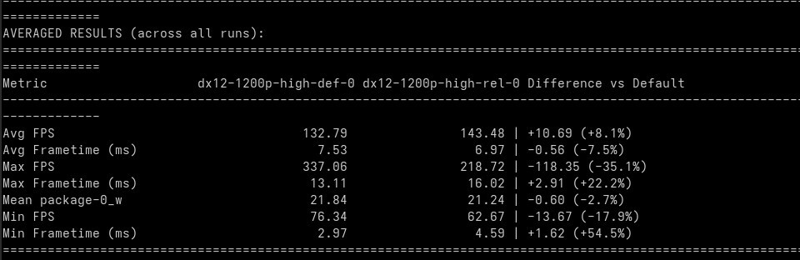
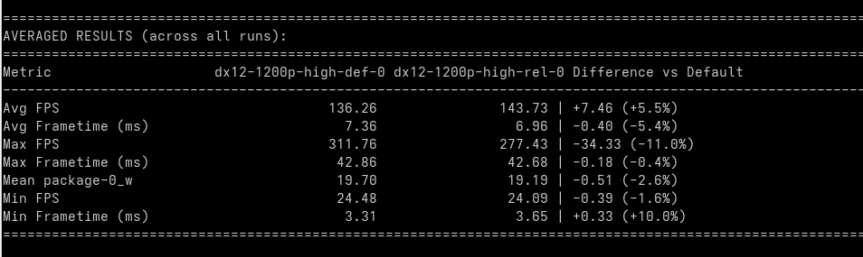
Backup — Strange Brigade (Other data)
Handheld
Laptop
25
Notes:
Reference slide, for the "what else can you set?" question. Do not read it.
Two things worth saying out loud if it comes up:
AC and DC are separate for every tuning knob, which is the mechanism for
"frames when plugged in, watts on battery". I have not measured DC at all,
so the DC columns in the shipped config are guesses. That is one of the
concrete experiments I would like named.
Omitted-means-unchanged is what makes the layering usable: the per-model
overlay can set one knob for one class without restating the whole block,
and without forcing a fallback value onto everything it did not mention.

Slide 26
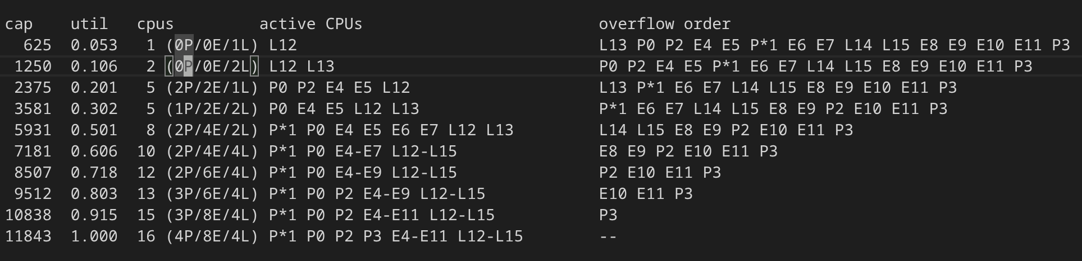
LAVD util vs CPUs

